Slide 1
Harnessing Real-Time Predictive Analytics to Optimize Booking Experiences on AirBnB, Austin
By Team 5:
Vaeshnavi Reddy Alla
Bhargava Devarakonda
Dheeraj Akash Dokuparthy
Satya Sai Karri
Varsha Monala
Dr. Lindi Liao
AIT 614: Big Data Essentials George Mason University
April 16th, 2024

Slide 2
Contents
introduction
Exploratory Data Analysis
Approach and models
Results
Conclusion

Slide 3



Introduction
Airbnb has become a prominent player in the sharing economy, revolutionizing tourism, and local exploration with its shared home offerings.
Finding the right lodging for guests is the key to Airbnb's success, which calls for real-time booking trend prediction. This study aims to predict the probability of a real-time reservation of a listing. Airbnb's sales staff might utilize this information to provide customers with a more personalized and effective booking experience.
Difference of solution from others:
We plan to use several models for predicting the probability of booking a listing. Also, we used the whole dataset instead of reducing it, used feature engineering for accurate predicting models.

Slide 4

Objective
The objective of this study is to develop a predictive model for determining the likelihood of real-time reservations for Airbnb listings. By analyzing booking trends in real-time, this project aims to empower Airbnb's sales team to offer customers a more personalized and efficient booking experience.

Slide 5
Task | Completion Date | Team Member
Data Cleaning and Preprocessing | 04/01/24 | Vaeshnavi Reddy Alla
EDA and data Visualization | 04/07/24 | Bhargava Devarakonda
Implementing Models | 04/13/24 | Varsha Monala
Reviewing the code and working system | 04/15/24 | Dheeraj Akash Dokuparthy
Documentation and Presentation | 04/16/24 | Satya Sai Karri
Summarized Project Timeline:

Slide 6
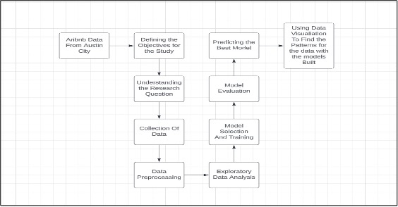
System Architecture:
The architecture explains the process that has be done to complete the project. The following are the steps:
Defining the objective of the project.
Understanding the objective.
Collecting the Data.
Data Preprocessing.
Data visualization to understand the features better.
EDA.
Model Selection and Training.
Model Evaluation.
Predicting the best model.

Slide 7
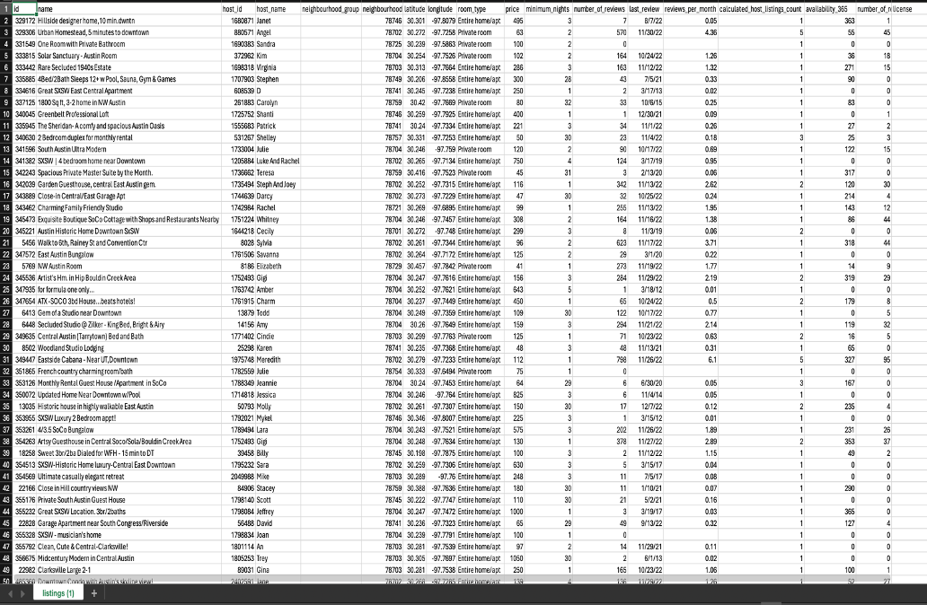
Dataset specimen:
The dataset has 13800 entries and 18 features, focusing on Airbnb properties in Austin, Texas. It contains host and customer information, property IDs, location, type, and price. Pre-processing is needed due to some null values. The goal is to enhance the booking experience for Airbnb customers, aiding client retention. Features like location, reviews, lodging type, and prices will be used to analyze customer bookings.

Slide 8

Data Processing and Analytical Approaches:
Explored dataset in Jupyter Notebook, addressing null values.
Used data visualization for insights.
Introduced booking rate variable.
Classified data into low, moderate, high booking rate categories.
Implemented PySpark ML algorithms: Logistic Regression, Random Forest, SVM.
Evaluated algorithm performance with accuracy metrics.

Slide 9
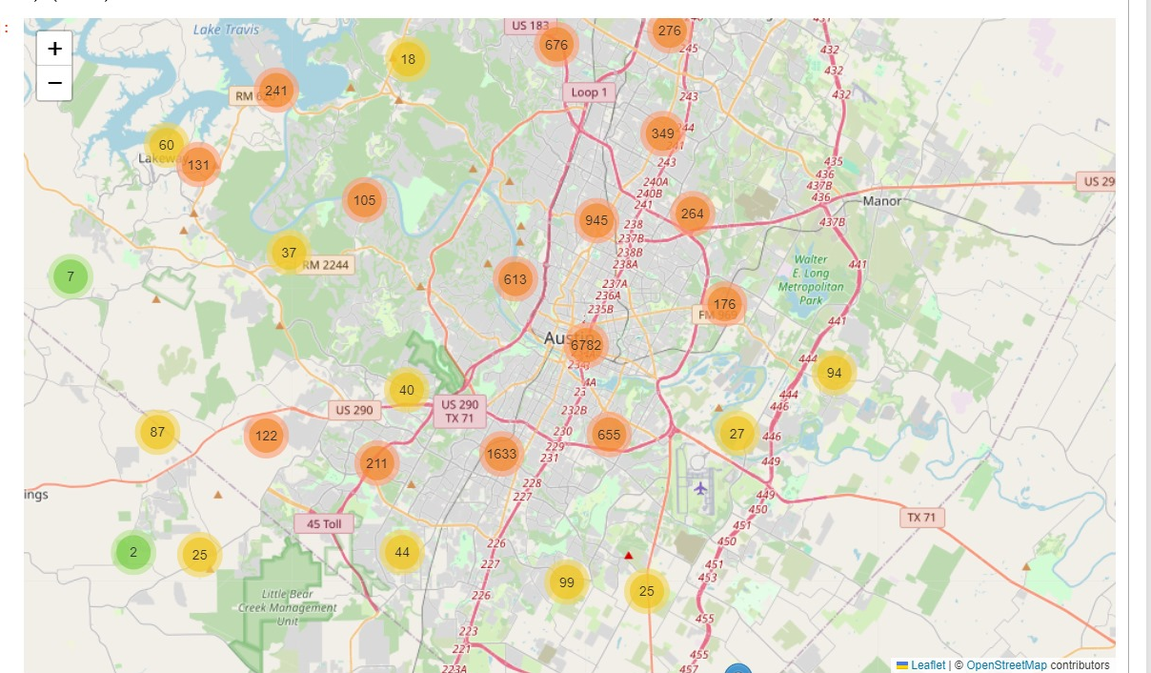
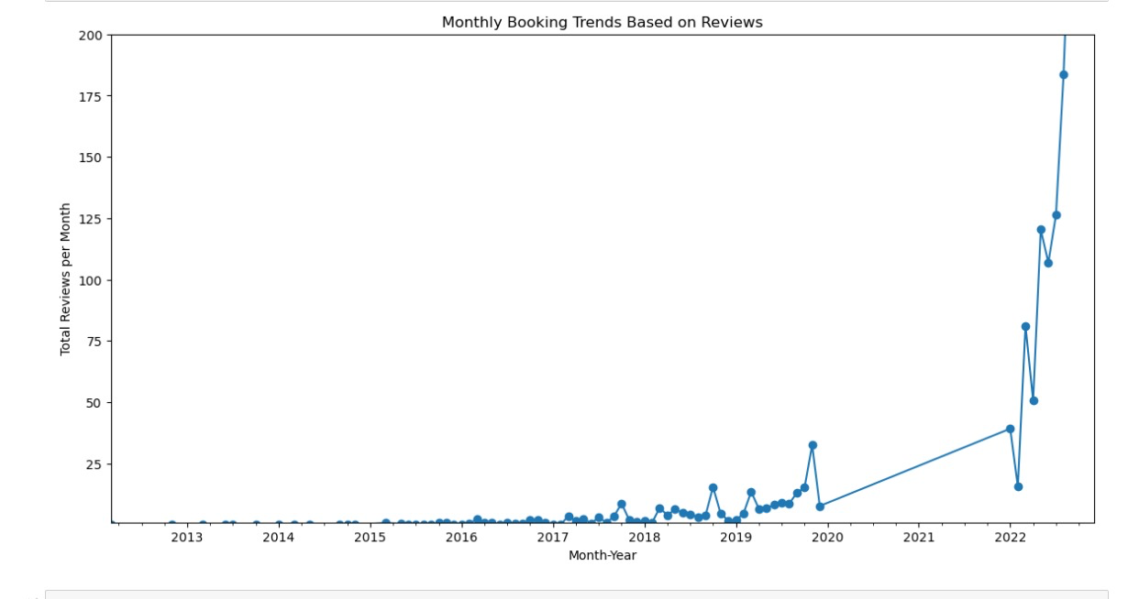
Data Visualization:
The first graph, shows the listings in an area, this is a map representation.
The second graph is a line graph represents the monthly booking trends based on the reviews.

Slide 10
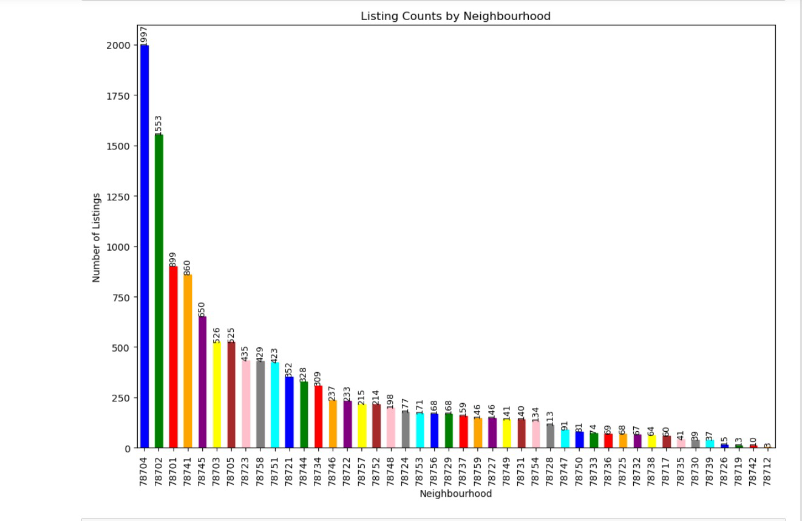
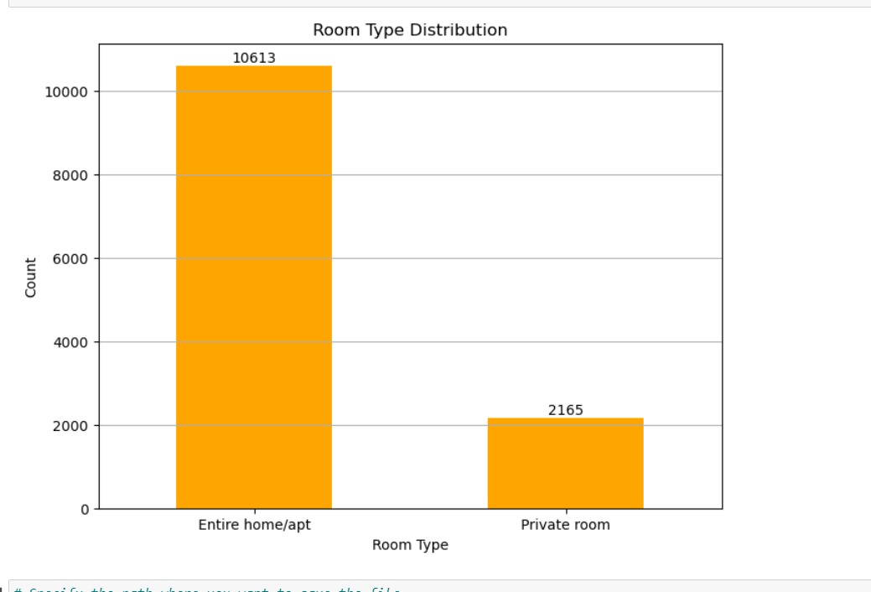
The first graph gives the information about the number of listings in a zip code.
The second graph represents the number of room types in the listings.

Slide 11
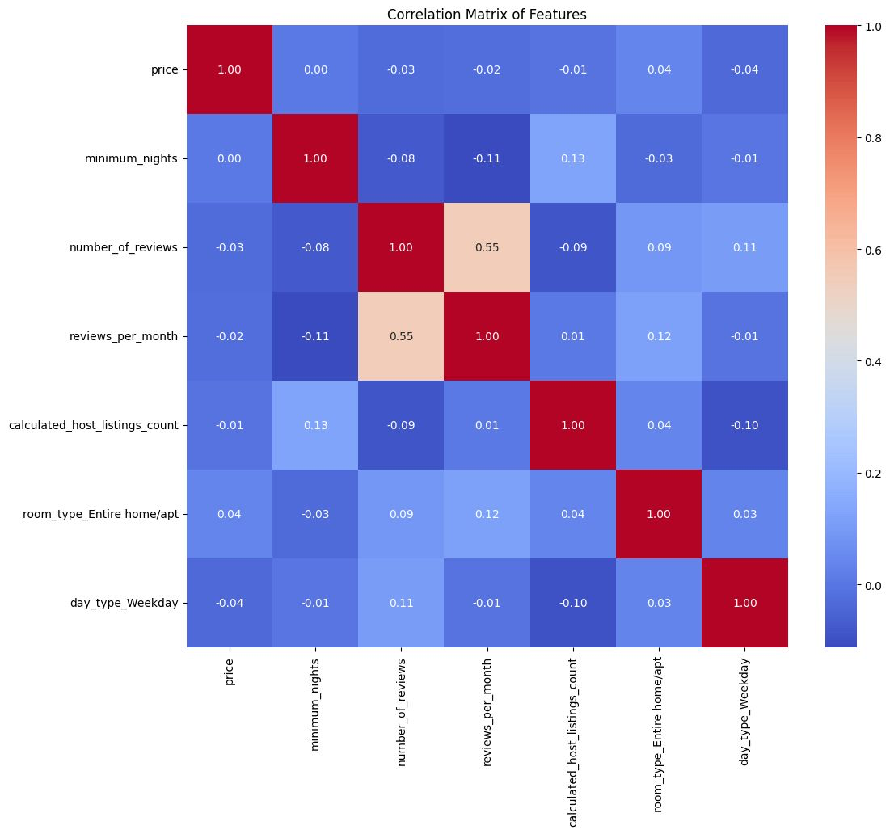
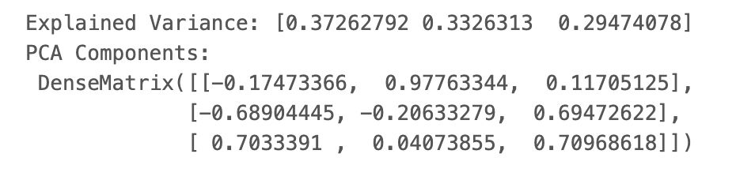
Experimental Results and Analysis:
Principal Component Analysis

Slide 12
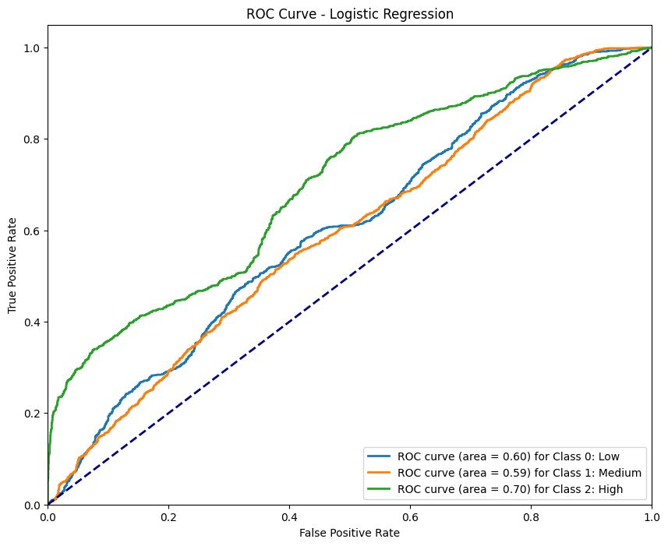
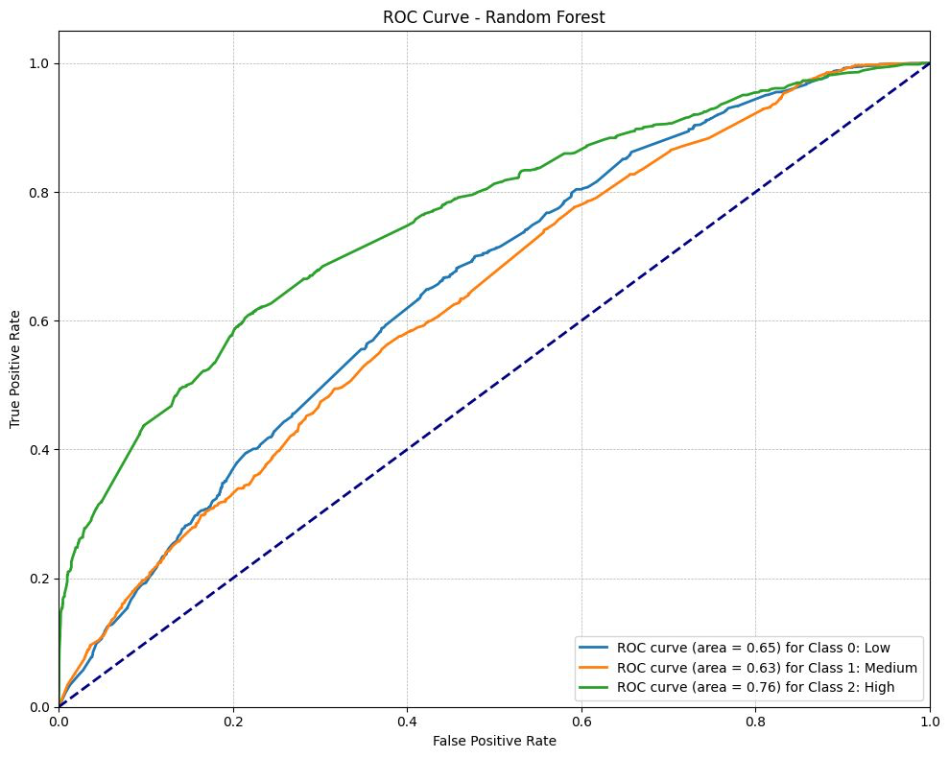
Experimental Results and Analysis
ROC Curves
LOGISTIC REGRESSION
RANDOM FOREST

Slide 13
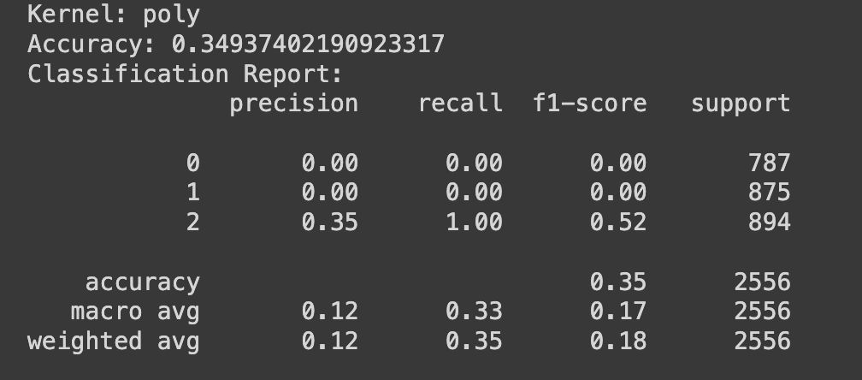
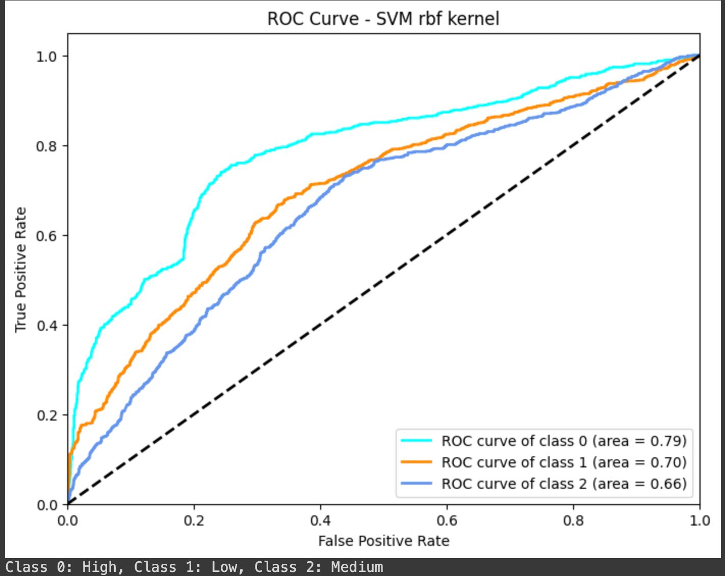
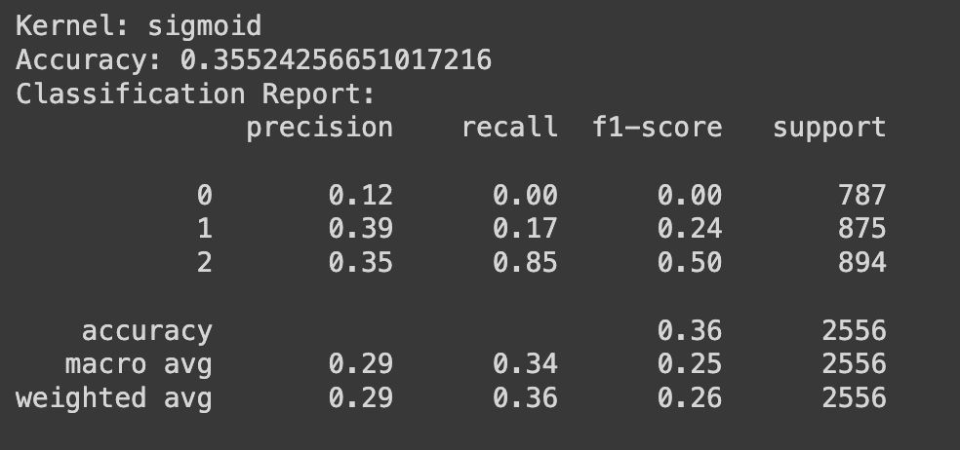
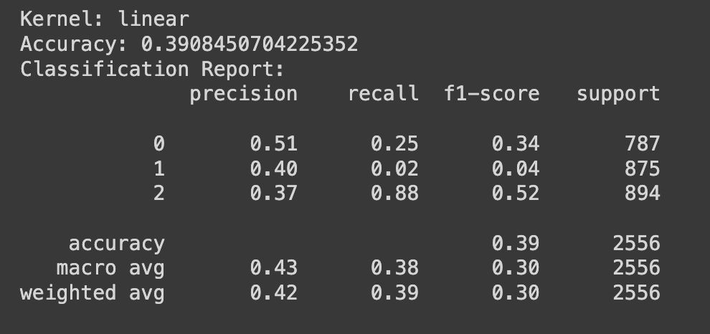
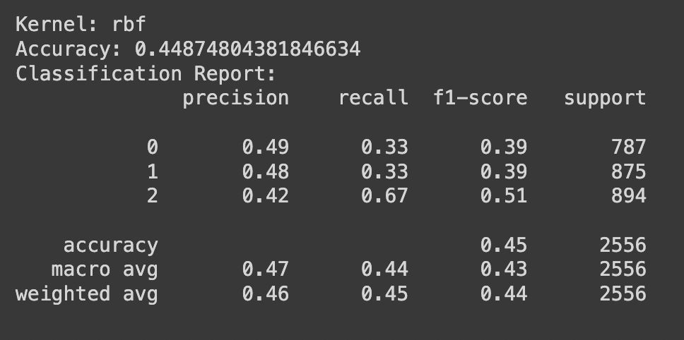
Experimental Results and Analysis:
Support Vector Machine

Slide 14

The accuracy for Logistic Regression Model is 42.66%
The accuracy for Random Forest Model is 48.92%
After running 4 different iterations of SVMs using the 4 kernels the best accuracy achieved is 46.87% with the rbf kernel.
By observing all the predictions we can conclude that this dataset is not suitable for predictions rather can be used for data visualizations.

Slide 15
Lessons Learned and Future Scope
Data cleaning was challenging due to the dataset's complexity, requiring extensive preprocessing for null values and inconsistencies.
Databricks' visualizations were less intuitive compared to other tools, but it excelled in handling large datasets efficiently and computing faster than Jupyter Notebook.
Combining Databricks for processing and Jupyter Notebook for visualization proved effective.
The dataset's scope could be improved with more varied data for better prediction of booking influences.
We saw slight gains in accuracy after using a number of models, such as Principal Component Analysis (PCA) and outlier elimination. In summary, the dataset doesn't seem to be good for making predictions; its value is more in data presentation than in predictive modeling.

Slide 16
References and Acknowledgement
Kalluru, V. (2018, October 8). 3 ways predictive analytics is transforming the hospitality industry - 7T, inc.: Dallas. 7T, Inc. | Dallas. https://7t.co/blog/3-ways-predictive-analytics- is-transforming-the-hospitality-industry/
Nandana Priyanka Eluri. (2021, March 17). Analysis of Airbnb Prices using Machine Learning Techniques. ieeexplore.ieee.org. https://ieeexplore.ieee.org/document/9376144/references#references
Santos, A. I. G. P., Perinotto, A. R. C., Soares, J. R. R., Mondo, T. S., & Cembranel, P. (2022, August 3). Expressing the experience: An analysis of airbnb customer sentiments. MDPI. https://www.mdpi.com/2673-5768/3/3/42
We are grateful to our professor Dr. Lindi Liao and GTA Parth Dalal for supporting and guiding us in gaining the knowledge during the course and to complete this project.

